Slide 1


Digital Portfolio
STUDENT NAME: Thenmozhi V
REGISTER NO AND NMID: asunm1451222407531
DEPARTMENT: B.SC COMPUTER SCIENCE.,.
COLLEGE:MAHALASHMI WOMEN’S COLLEGE OF ARTS & SCIENCE
UNIVERSITY OF MADRAS

Slide 2


PROJECT TITLE :
Digital Portfolio

Slide 3


AGENDA :-
Problem Statement
Project Overview
End Users
Tools and Technologies
Portfolio Design and Layout
Features and Functionality
Results and Screenshots
Conclusion
Github Link
3/21/2024 Annual Review

Slide 4

PROBLEM STATEMENT
In this generation Many Job applicants need their skill to showcase with the wide digital !
∗ It clearly states Opportunity that the portfolio will address , Such as User’s difficulty in Finding specific information to better showcase their skills.
∗ It Guides the Creation of the Digital Portfolio.
∗ A portfolio displays tangible evidence of relevant work, proving skills and qualifications of your’s

Slide 5

PROJECT OVERVIEW
• A student digital portfolio is a dynamic online showcase of a student's academic and personal growth over time.
• It goes beyond a traditional resume or report card by featuring curated work samples, reflections on the learning process, and multimedia elements that bring a student's skills and personality to life.

Slide 6

Key components of my portfolio include as my name and my carrier summary .
My Projects :
A Simple Responsive Website:
Automatically adjusts its layout, images, and content to fit the screen size of any device, such as a desktop, tablet, or smartphone, ensuring a consistent and optimal user experience across all platforms
*
JavaScript-based quiz app:
*
Building a quiz app with JavaScript involves creating the HTML structure, defining the questions and logic in JavaScript, and adding styling with CSS. The core JavaScript handles displaying questions, checking answers, tracking the score, and moving between questions.

Slide 7
Personal blog with CMS.
*
For a personal blog with a Content Management System (CMS), your best options range from highly flexible, self-hosted platforms to simpler, all-in-one hosted website builders. Your choice depends on your technical comfort level, how much control you want, and your budget
Contact information:
• A way to send a message on the site include a dedicated “Contact Me” page with a clear heading, a professional email address, and a direct message, your name.
•The Fields are required to fill.

Slide 8


WHO ARE THE END USERS ?
• The end users for portfolios encompass a wide range of individuals across all career stages, from students to seasoned professionals.
• They use portfolios to showcase their skills, accomplishments, and experience to secure jobs, land clients, gain admission to academic programs, or document their professional growth
Students : High school students ; College Students ; Recent Graduates.
Job Seekers : Creative Fields ; Technical Roles ; All Job Seekers.
Freelancers : Creative Freelancers ; Developers and Consultants ; Service Professional .
Professionals : Experienced Employees ; Networkers ; Educators and Mentors.

Slide 9


TOOLS AND TECHNIQUES
Foundational tools and techniques :
• HTML: Structure and semantics
External Links { styles.css ; script.js }
• CSS: Styling and layout
Responsive design { CSS Flexbox ; CSS Grid }
• JavaScript: Interactivity and dynamic content
Visual Studio : A free, lightweight, and extensible code editor. It offers a powerful development environment for building a static portfolio with HTML, CSS, and JavaScript
Github : A free hosting service from GitHub that publishes a static website directly from a repository. It's ideal for a developer portfolio because it showcases your code and provides a live site.

Slide 10

POTFOLIO DESIGN AND LAYOUT :
Information
About Me
My Projects
Contact Me
To create an effective and responsive portfolio, focus on a clear layout, a curated selection of your best work, and a design that adapts to any screen size. The following guide outlines the structure and design principles for building a professional portfolio with the sections you specified

Slide 11

FEATURES AND FUNCTIONALITY
Navigation bar
A clear and consistent navigation bar is critical for helping visitors find their way around your site.
• A strong portfolio website showcases your skills and personality through key features that provide a clear and engaging user experience.
• Essential components include intuitive navigation, a project gallery, interactive elements, a contact form, and a responsive design that adapts to all screen sizes
Navigation bar : A clear and consistent navigation bar is critical for helping visitors find their way around your site.
Project showcase : This is the central feature of your portfolio, where you present your best work with high-quality visuals and detailed descriptions.
Interactive elements : Interactive features engage your audience and create a more memorable experience.

Slide 12
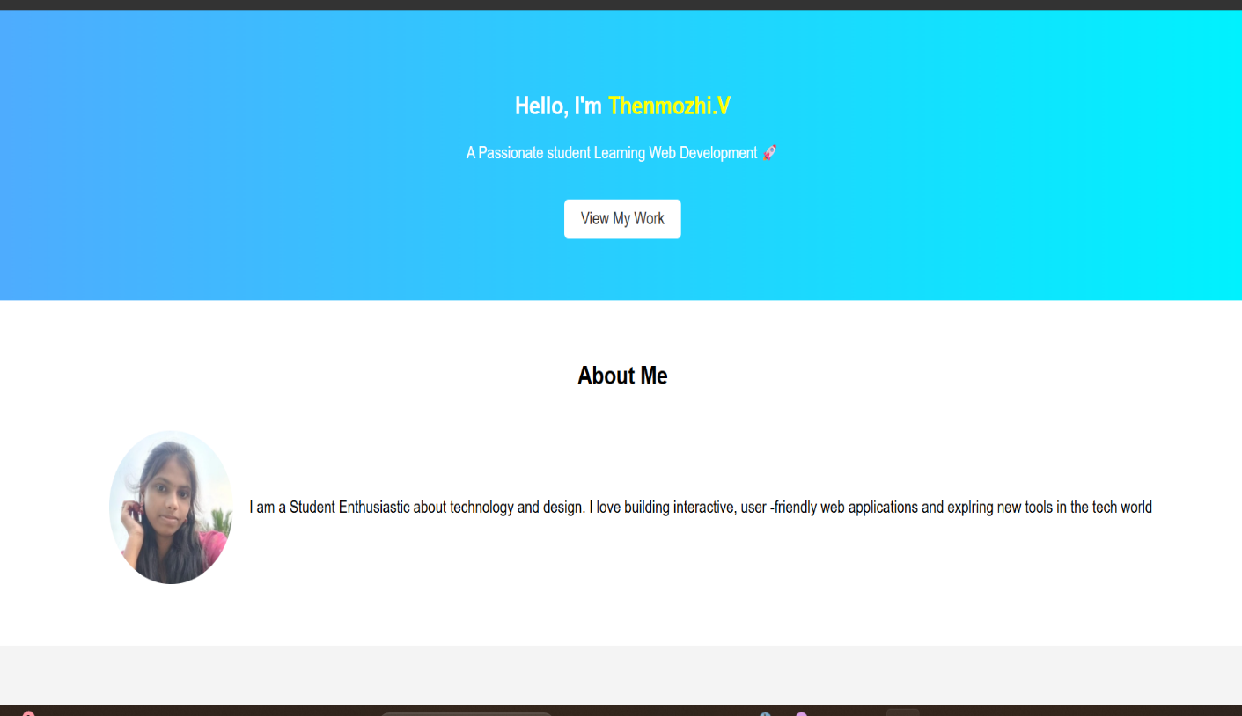
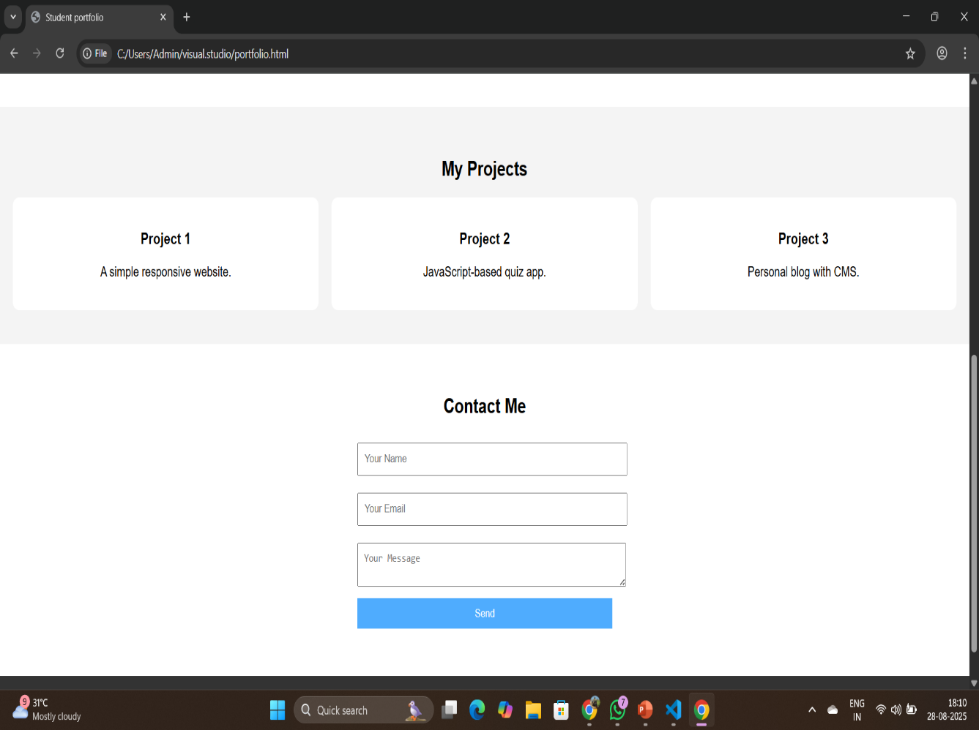
RESULTS AND SCREENSHOTS
12

Slide 13

CONCLUSION :
* While the final products on display are a source of pride, the process behind them is the true highlight.
* Through projects like the Digital Portfolio website redesign, I honed my skills in collaborative problem-solving, stakeholder communication, and iterative development.
* I discovered that active communication and a deep understanding of user needs were the keys to a successful outcome.
* This experience has been instrumental in shaping my approach to design, reinforcing that a clear process is just as important as a compelling result

